Slide 1
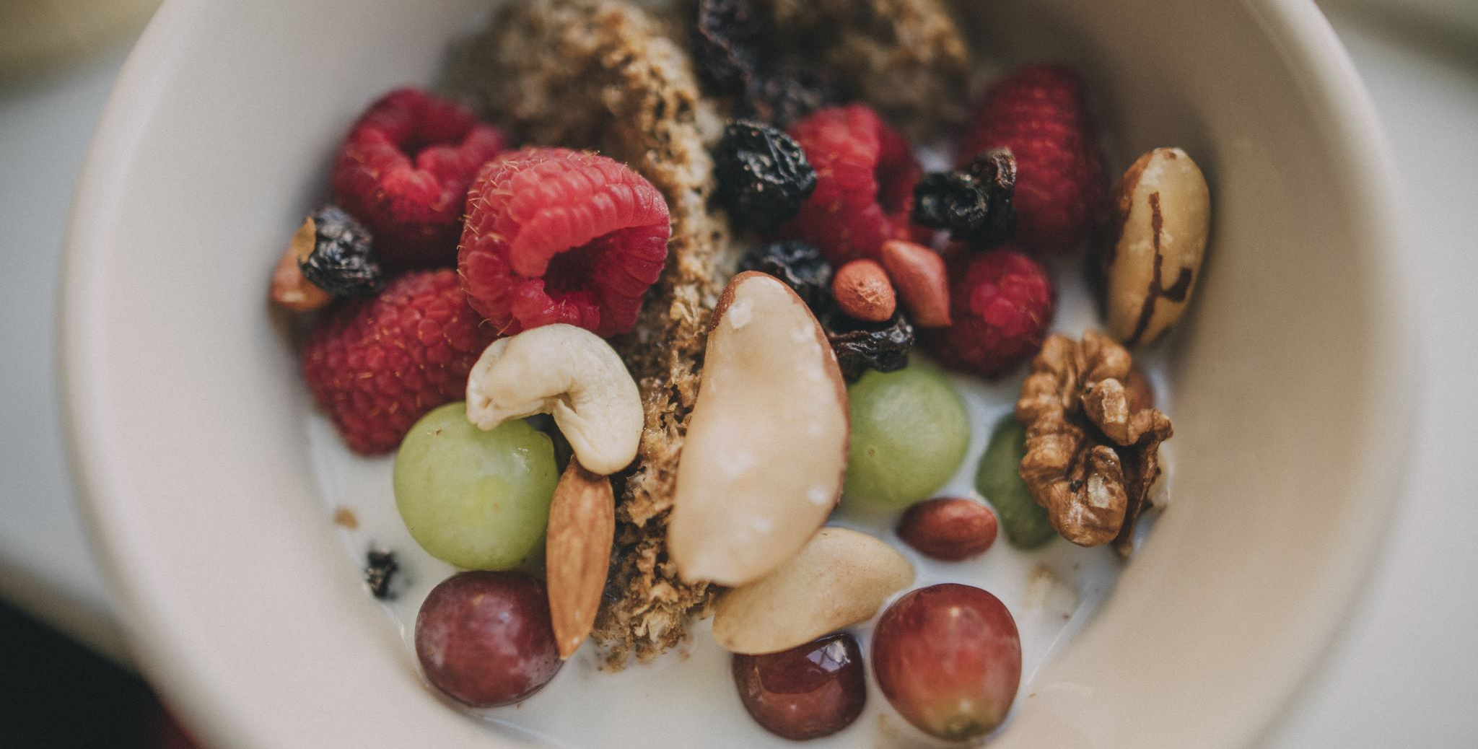

ERASMUS
,,CIBO IN CIRCOLO:UN NUOVO PARADIGMA”
Bejenaru Bianca Naama
Dabija Isabela
Perju Catalin
Jugaru Emanuel

Slide 2
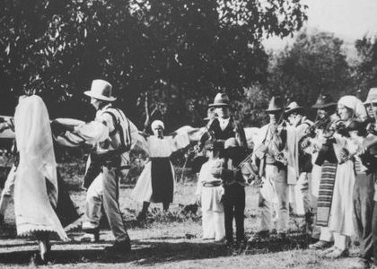
Oltenia
In Oltenia coexist people for whom the tradition meant something almost sacred, with rules of Christian goodwill, with well-defined habits and ordinances and respected with holiness. The inhabitants of Oltenia, like all Romanians, think in a Latin way and are, together with the Greeks, one of the oldest Christian peoples in southeastern Europe. The people from Oltenia are proud, loving, sociable, they love their place and do not hesitate to show it to those who want to see it.

Slide 3
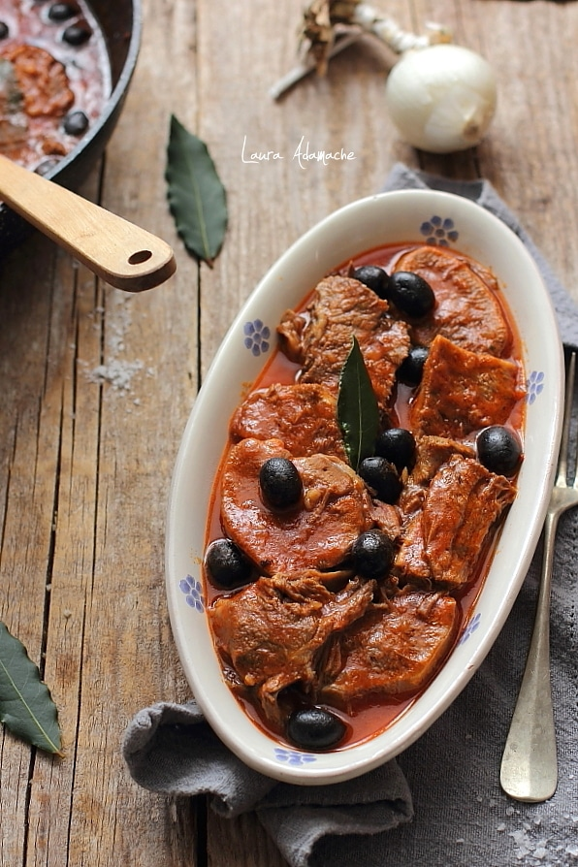
Pork with leeks and olives
Pork with leeks and olives
Preparation: Wash the pork tongue well, put it in boiling water, and when it is boiled, cut it into pieces and remove the skin. Stir in the onion separately, and when it turns golden, add the diced leeks, olives and pork tongue. Then pour approx. 150 ml of dry or semi-dry white wine, then put the water in which the tongue was boiled. At the end, when it already has a consistency, add the tomato sauce. Let it boil for about 15 minutes, then put it in the oven for 30 minutes at 180 degrees.

Slide 4
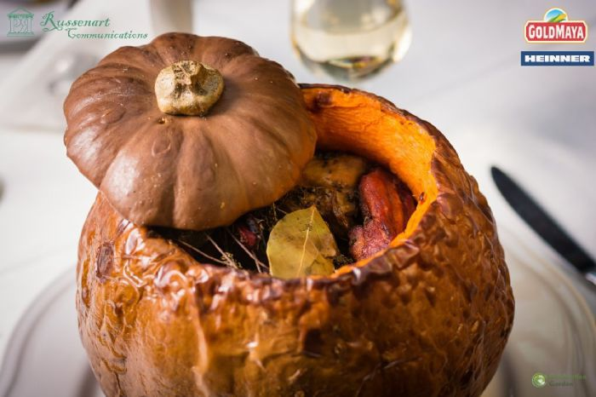
Sarmale in pumpink
Sarmale in pumpkin
Preparation: Peel a squash, grate it and season it with salt. Fry the onion, and when it becomes glassy, golden, add the rice and tomato sauce. After the composition has cooled, mix with the minced pork and sauté in cabbage leaves. Boil approx. After 60 minutes, put a bed of bay leaves in the pumpkin, add the sarmales and the smoked ribs on top. Place in the oven for about 3 hours on medium heat (150 degrees medium).

Slide 5
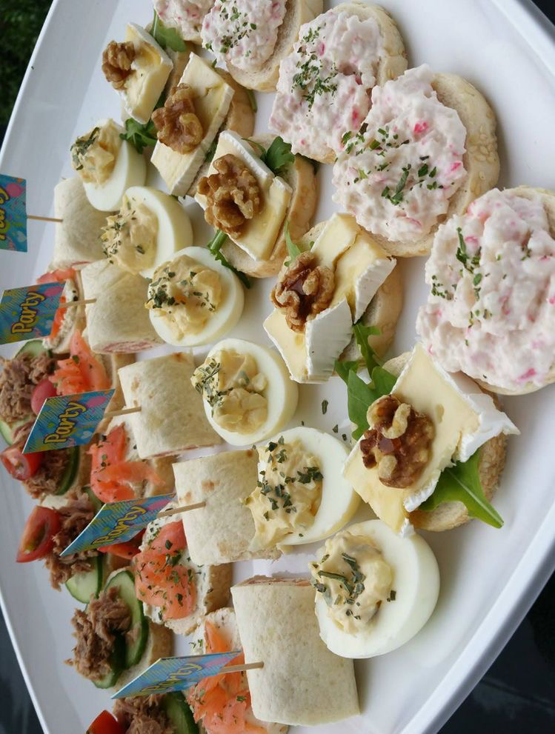
OLTENIA cuisine
Oltenia cuisine keep the habit of preparing food in earthenware pots for "test", a technology that gives a special taste to food, they carry the scent of our peasant cuisine.Oltenians are accustomed to spice up the dishes, the star ingredient being hot pepper or horseradish. There are also greens from Oltenian dishes, such as leeks, stevia, nettles, green onions, parsley or dill.

Slide 6
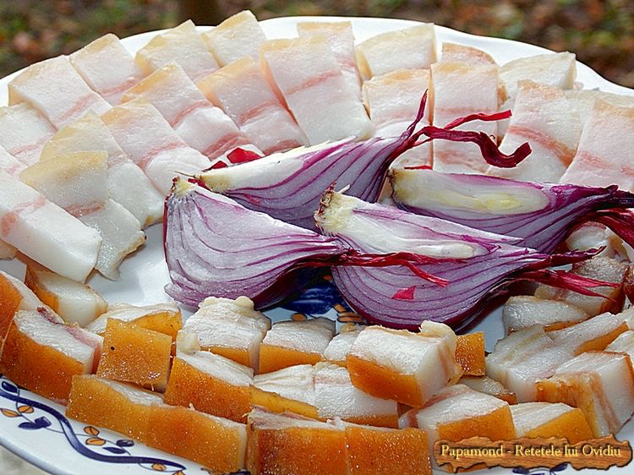
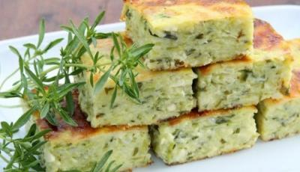
Zucchini pudding
The zucchini are cleaned, cut and boiled in salted water, after they have boiled, they are left to drain well, then they are passed, adding salt, butter, sour cream and finely chopped greens, after the composition is well mixed, put the beaten egg whites and chew, grease a tray with oil and cover with breadcrumbs, pour the composition and put in the oven.

Slide 7
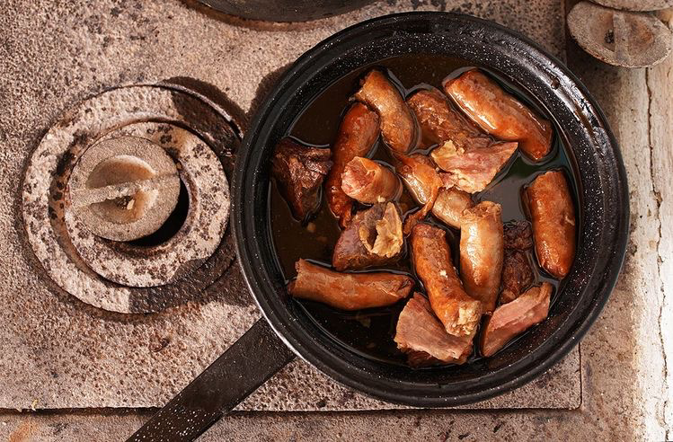
CONCLUSION
In conclusion, oltenian cuisine is widely used for vegetables, fish, poultry and pork, dairy products and cheeses. From these ingredients are prepared dishes such as leek soup, stevia, Oltenian stew. Sarmalele are traditionally cooked in earthenware pots in a "test" (a kind of oven). The inns or the big restaurants also had important influences, such as the Manuc Inn, the Capsa restaurant. Representative desserts are: pies, fruit compotes, pasta puddings.

